Slide 1
Using a package manager

Slide 2
A package manager is a central repository to centralize and share packages, development libraries, tools, and software. There are many public package managers, such as NuGet, npm, Maven, Bower, and Chocolatey, that provide frameworks or tools for developers in different languages and platforms
The following screenshot is from the NuGet package manager, which publicly provides more than 150K .NET Frameworks:

Slide 3
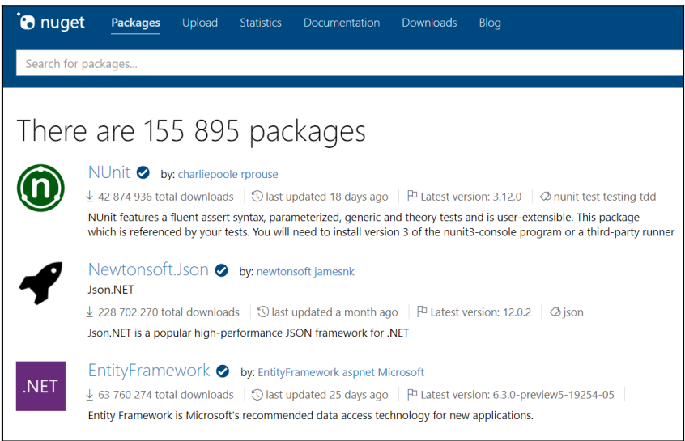

Slide 4
One of the advantages for the developer of using this type of package manager is that they don't have to store the packages with the application sources, but can make them a reference in a configuration file, so the packages will be automatically retrieved.
In an enterprise application, things are a little different because, although developers use packages from public managers, some elements that are generated in an enterprise must remain internal.
Indeed, it is often the case that frameworks (such as NuGet or npm libraries) are developed internally and cannot be exposed publicly. Moreover, as we have seen in the CI/CD pipeline, we need to make a package for our application and store it in a package manager that will be private to the company.
That's why looking at package managers such as NuGet and npm, which can be used within an enterprise or for personal needs, is suggested.
Package Managers helps in the installation of different software without worrying about dependencies and versions. They are updated frequently and packages run through some tests to check security and other things.

Slide 5
Private NuGet and npm repository:
If you need to centralize your NuGet or npm packages, you can create your own local repository.
The problem with installing one repository per package type method is that we need to install and maintain a repository and its infrastructure for the different types of packages.
This is why it is preferable to switch to universal repository solutions such as Nexus (Sonatype), ProGet, and Artifactory for on-premise solutions, and Azure Artifacts or MyGet for SaaS solutions.
To understand how a package manager works, we will look at Nexus Repository OSS and Azure Artifacts.

Slide 6
Nexus rEpository oss
Nexus Repository OSS is an open source repository that supports many artifact formats, including Docker, Java™, and npm. With the Nexus tool integration, pipelines in your toolchain can publish and retrieve versioned apps and their dependencies by using central repositories that are accessible from other environments.
Nexus Repository Manager OSS is a free-to-use artifact repository.
Install Nexus:
1.Log on to the Nexus server.
2.Download the Nexus 2.9. 0 or later zip file and unzip the content to a directory of your choice. See Installing Nexus. ...
3.Open the command prompt and start Nexus. Linux: cd <nexus-install-directory> ...
4.Stop Nexus. Linux: ./bin/nexus stop.

Slide 7
What are the different types of repository in Sonatype Nexus OSS?
Nexus Repository Manager provides for three different kinds of repositories:
1.Proxy repositories,
2. Hosted repositories and
3.Virtual repositories.
Once Nexus Repository is installed, we must create a repository by following these steps:
In the Repositories section, click on the Create repository button.
2.Then choose the type of packages (for example, npm, NuGet, or Bower) that will be stored in the repository, as shown in the following screenshot.
Nexus is a high-performance and widely used enterprise repository, but it requires effort to install and maintain it. This is not the case for SaaS package managers, such as Azure Artifacts, which we'll look at now.

Slide 8
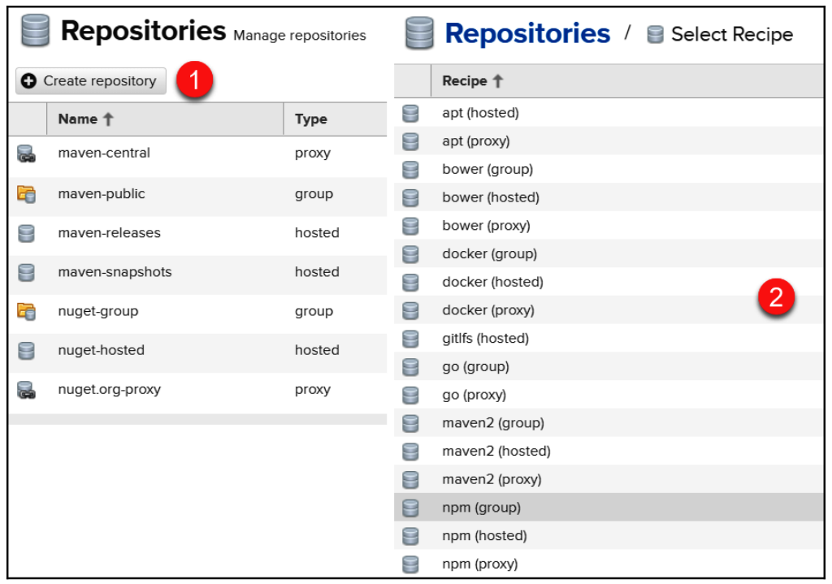

Slide 9
Azure artifacts
Azure Artifacts is part of the Azure DevOps suite of tools. It serves as a centralized environment for developers to share and manage code, packages and artifacts. The service helps developers locate, install and publish NPM, NuGet, Python and Maven package.
Azure Artifacts enable developers to consume and publish different types of packages to Artifacts feeds and public registries such as NuGet.org and npmjs🐼
What are the types of Azure Artifacts?
Within Azure DevOps, artifacts can get subdivided into three main categories:
1.build artifacts,
2. pipeline artifacts, and
3. Azure artifacts.
Outside Azure DevOps, the general categories are project management artifacts and code artifacts

Slide 10
Azure Artifacts tutorial: Get started:
To use Azure Artifacts, you need an Azure DevOps account.
If you already have an account, log in using that account. If not, create an account via Microsoft's DevOps portal or the GitHub sign-up page.
Then, follow these steps to publish a NuGet package:
Create an Azure DevOps organization:
In Azure DevOps, an organization helps you work with several related projects. To create an organization in Azure DevOps, follow these steps:
Once you've signed into Azure DevOps, click New Organization
Specify the name of the organization
Specify where you want the organization to be hosted
Click Continue
You can view your artifacts and their usage limits from Organization Settings.

Slide 11
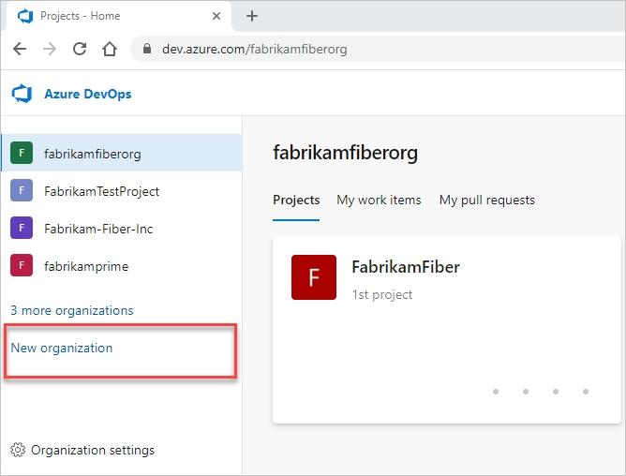

Slide 12
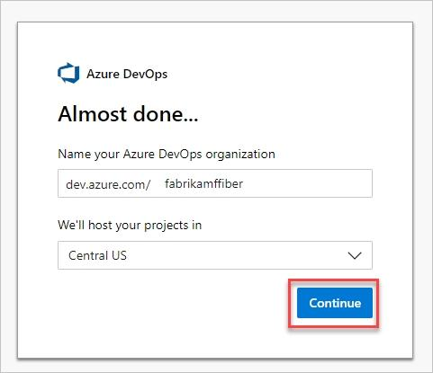

Slide 13
2. Create a project:
A project in Azure DevOps is used to set up a repository that contains source code and to plan, track and manage the work.
To create a new project in Azure DevOps, follow these steps:
On the Azure DevOps page, select your desired Organization
2.Click New Project
3.Specify a name and description for your project.
4.Specify visibility (Public or Private) for your project
5.Select your preferred version control system
6.Select the work item process template
7.Click Create to complete the process

Slide 14
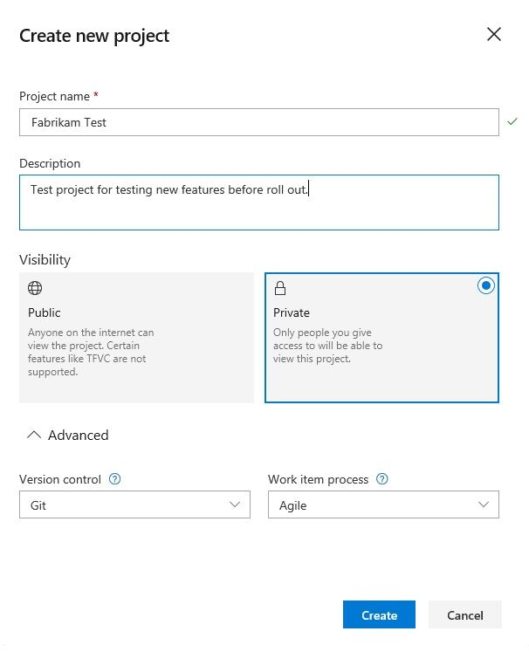

Slide 15
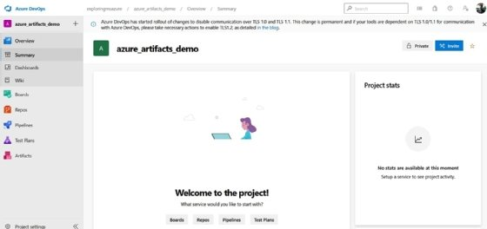

Slide 16
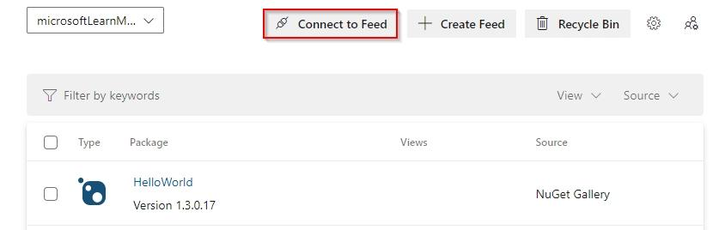
3. Connect to a feed
Next, we connect to an Azure Artifacts feed, which is where developers store and share packages. To connect to a particular feed, follow these the steps:
Select Artifacts
Click Connect to Feed

Slide 17
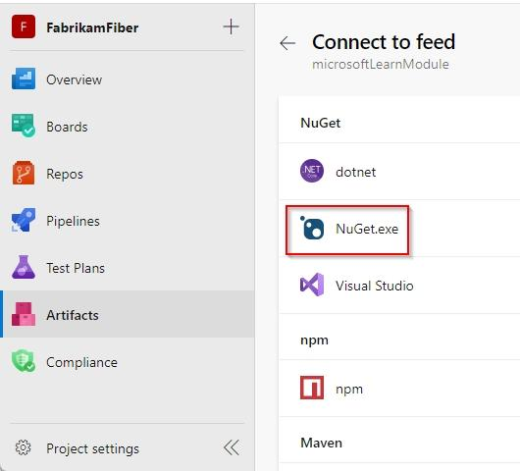
3.Select the feed you want to connect to. In this Azure Artifacts tutorial, we'll connect to the NuGet feed, as shown in Figure 4
4.Follow the instructions provided in the nuget.config.file to set up your project

Slide 18
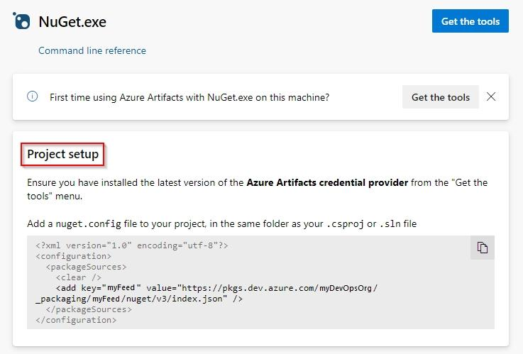

Slide 19
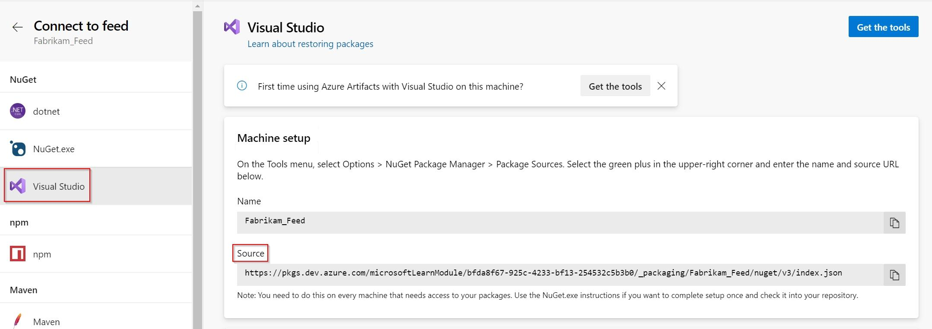

Slide 20
4. Publish the package(s):
To publish the NuGet package to your feed, type the command below at an elevated command prompt:
nuget push <PACKAGE_PATH> -src https://pkgs.dev.azure.com/<ORGANIZATION>/<PROJECT>/_packaging/<FEED>/nuget/v3/index.json -ApiKey <STRING_VALUE>

Slide 21
JENKINS

Slide 22
INTRODUCTION
Jenkins is a Java-based open-source automation platform with plugins designed for continuous integration. It is used to continually create and test software projects, making it easier for developers and DevOps engineers to integrate changes to the project and for consumers to get a new build.

Slide 23
INSTALLING JENKINS
STEP 1: Search Jenkins download in google
STEP2: Download Jenkins war file
STEP3:Download jdk 17 version
STEP4:Install jdk and Jenkins by giving localhost 8080
STEP5:Select the path of jdk17 in Jenkins installation
STEP6:search for localhost 8080 in google click the link.
STEP7:set the username and password now the Jenkins is completely installed to create new job

Slide 24
Configuring Jenkins
STEP1: First, we will create a new job, by clicking on New Item or on the create new jobs link, as shown in the following screenshot: Continuous Integration and Continuous Delivery
STEP2: On the job configuration form, enter the name of the job, for example, demoCI, and choose the Freestyle project template, then validate that by clicking on OK.

Slide 25
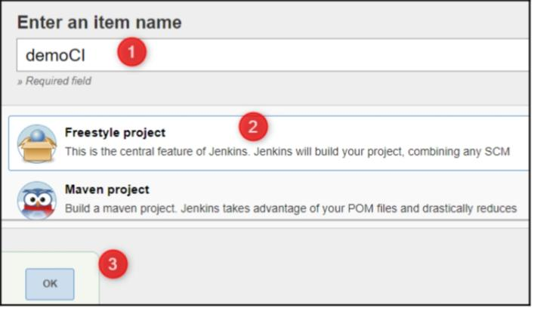

Slide 26
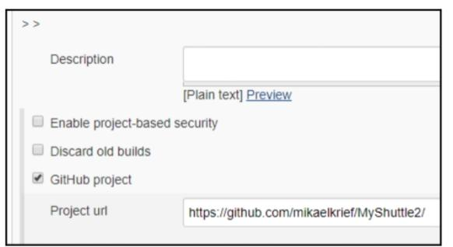

Slide 27
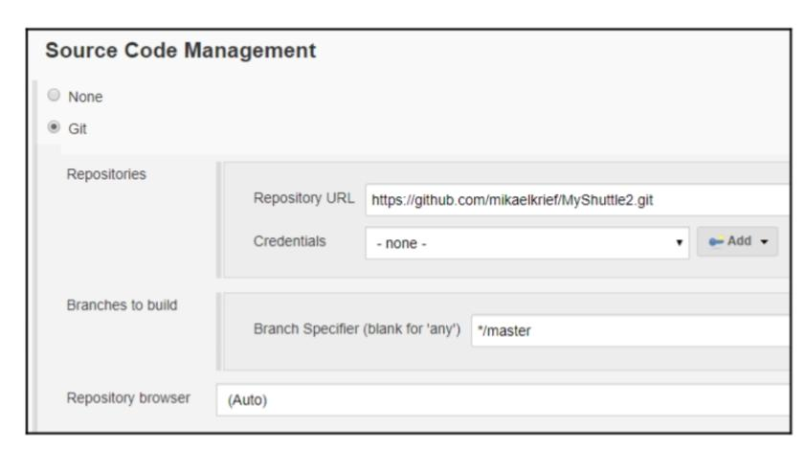

Slide 28
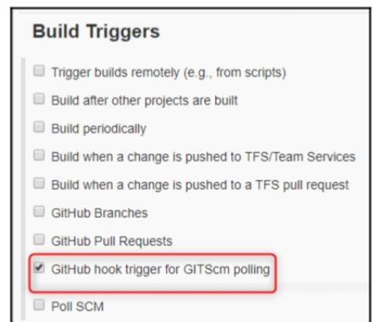

Slide 29
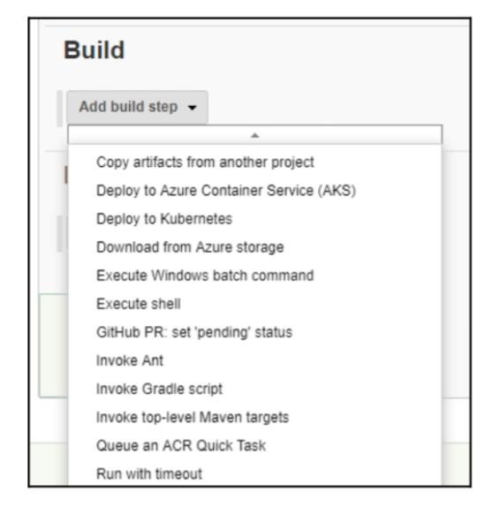

Slide 30
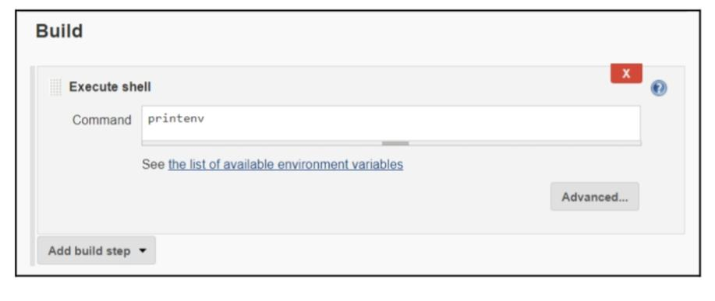

Slide 31
Continued…
STEP3:.Then, we configure the job with the following parameters: In the GitHub project input, we enter the URL of the GitHub repository as follows: Continuous Integration and Continuous Delivery In the Source Code Management section, enter the URL of the GitHub repository and the code branch, like this: In the Build Triggers section, check the GitHub hook trigger for GITScm polling box, like this: Continuous Integration and Continuous Delivery. In the Build section, in the actions drop-down list, for this lab we'll choose the Execute shell step. You can add as many actions as necessary to your CI (compilation, file copies, and tests). Inside the textbox of the shell command, we enter the printenv command to be executed during the execution of the job pipeline: Continuous Integration and Continuous Delivery.

Slide 32
Continued…
STEP4:.Then, we finish the configuration by clicking on Apply and then on the Save button. Our Jenkins CI job has now been created and is configured to be triggered during a commit and to perform various actions. We will now run it manually to test its proper functioning

Slide 33
CONFIGURING GITHUB WEBHOOKS
STEP1: In the GitHub repository, go to the Settings | Webhooks menu.
STEP2: Click on the Add Webhook button. STEP3: In the Payload URL field, fill in the URL address of Jenkins followed by
/github-webhook/, leave the secret input as it is, and choose the Just the push
event option.
Validate the webhook.

Slide 34
Continued….
STEP4: The following screenshot shows the configuration of a GitHub webhook for jenkins
STEP5: Finally, we can check on the GitHub interface, as shown in the following
screenshot, that the webhook is well configured and that it communicates with jenkins

Slide 35
Continuous integration and continuous delivery technical requirements

Slide 36
Using Azure Pipelines
-> Versioning of the code with GIT in Azure repos
-> Creating the CI Pipelines
-> Creating the CD Pipeline : the release

Slide 37
Azure Pipelines
Azure Pipelines is one of the services offered by Azure DevOps. It was previously known as Visual Studio Team Services (VSTS).
Azure DevOps is a complete DevOps platform provided by Microsoft that is fully accessible via a web browser and requires no installation.

Slide 38
It is very useful for following reasons:
The DevOps tools manage its code in Version Control System (VCS).
It manages a project in agile mode.
It deploys applications in a CI/CD pipeline , to centralize packages.
It performs manual test plans.

Slide 39
Each of these features is combined into services that are summarized in this table:
Service name | Description
Azure Repos | It is a SCV, which we looked at in the previous chapter.
Azure Boards | It is a service for project management in agile mode with sprints, backlogs, and boards.
Azure Pipelines | It is a service that allows the management of CI/CD pipelines.
Azure Artifacts | It is a private package manager.
Azure Test Plans | It allows you to make and manage a manual test plan.

Slide 40
-> Azure DevOps is free for up to five users. -> Azure DevOps supports a collaborative culture and set of processes that bring together developers, project managers, and contributors to develop software. -> It allows organizations to create and improve products at a faster pace than they can with traditional software development approaches. -> You can work in the cloud using Azure DevOps Services or on-premises using Azure DevOps Server. .
Azure DevOps:

Slide 41
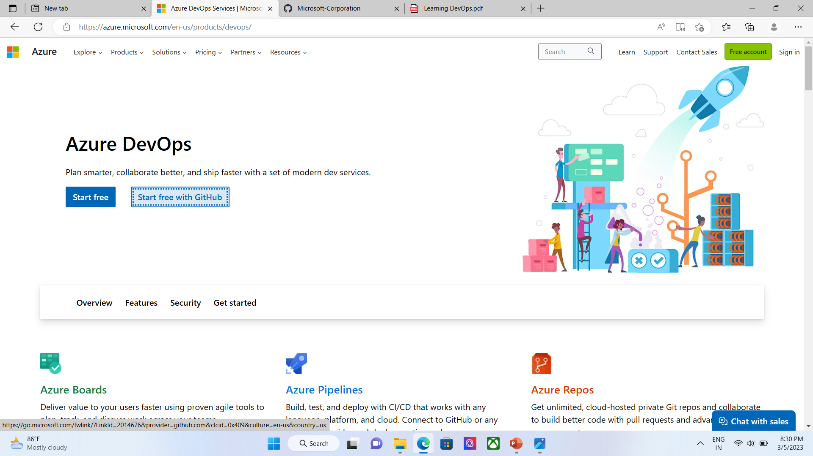
To register with Azure DevOps and create an account, called an organization, “we need either a Microsoft live account or a GitHub account”, and to follow these steps: STEP1. In your browser, go to this URL: https://azure.microsoft.com/en-us/ services / DevOps /.

Slide 42
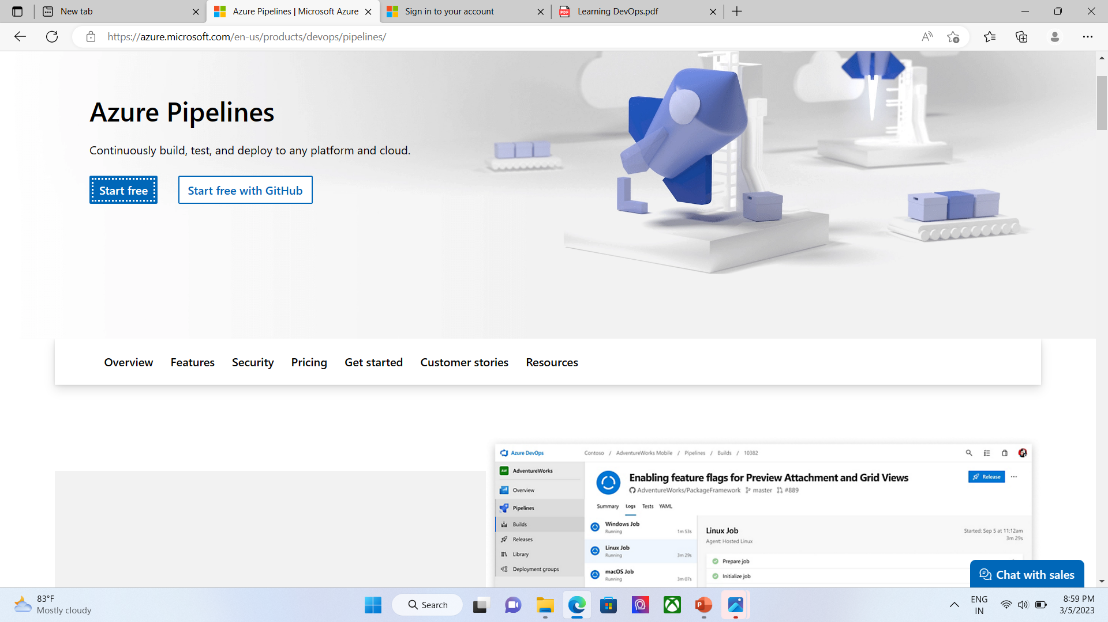
STEP2: Click on the Signup button either using GitHub or Microsoft account. STEP3: As soon as we register, the first step suggested is to create an organization with a unique name of your choice and the Azure location, for example, Book Labs for the name of the organization. STEP4: click next.

Slide 43
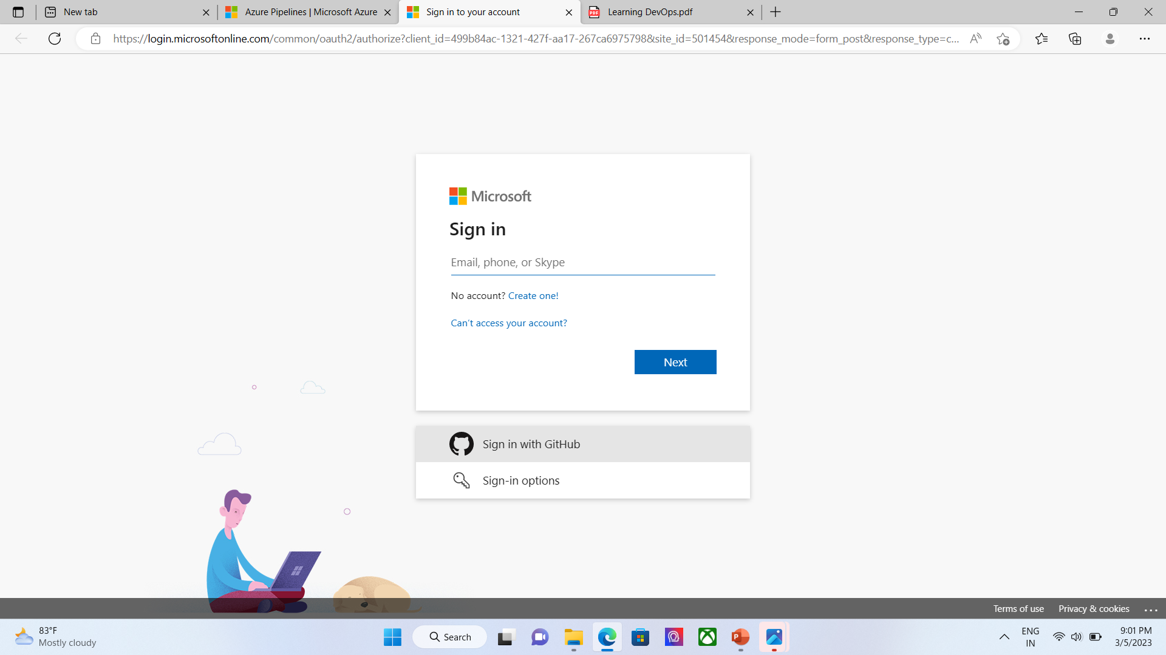

Slide 44
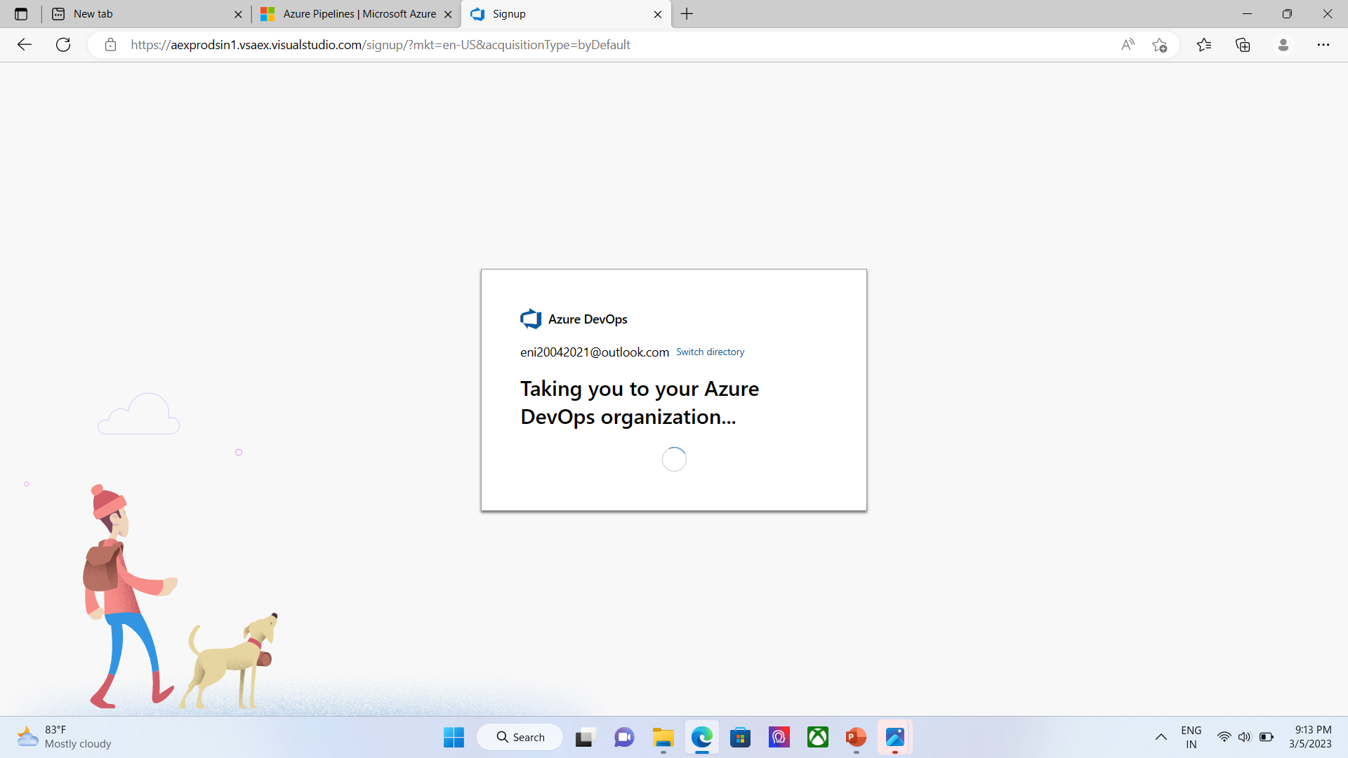
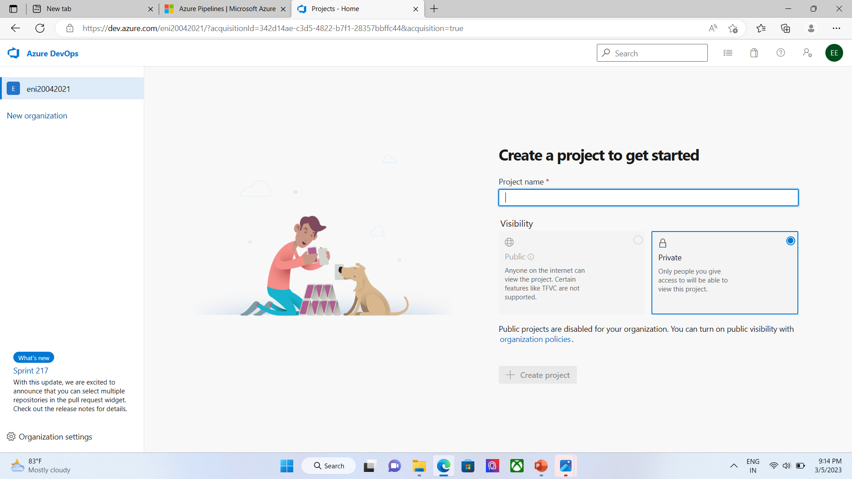

Slide 45
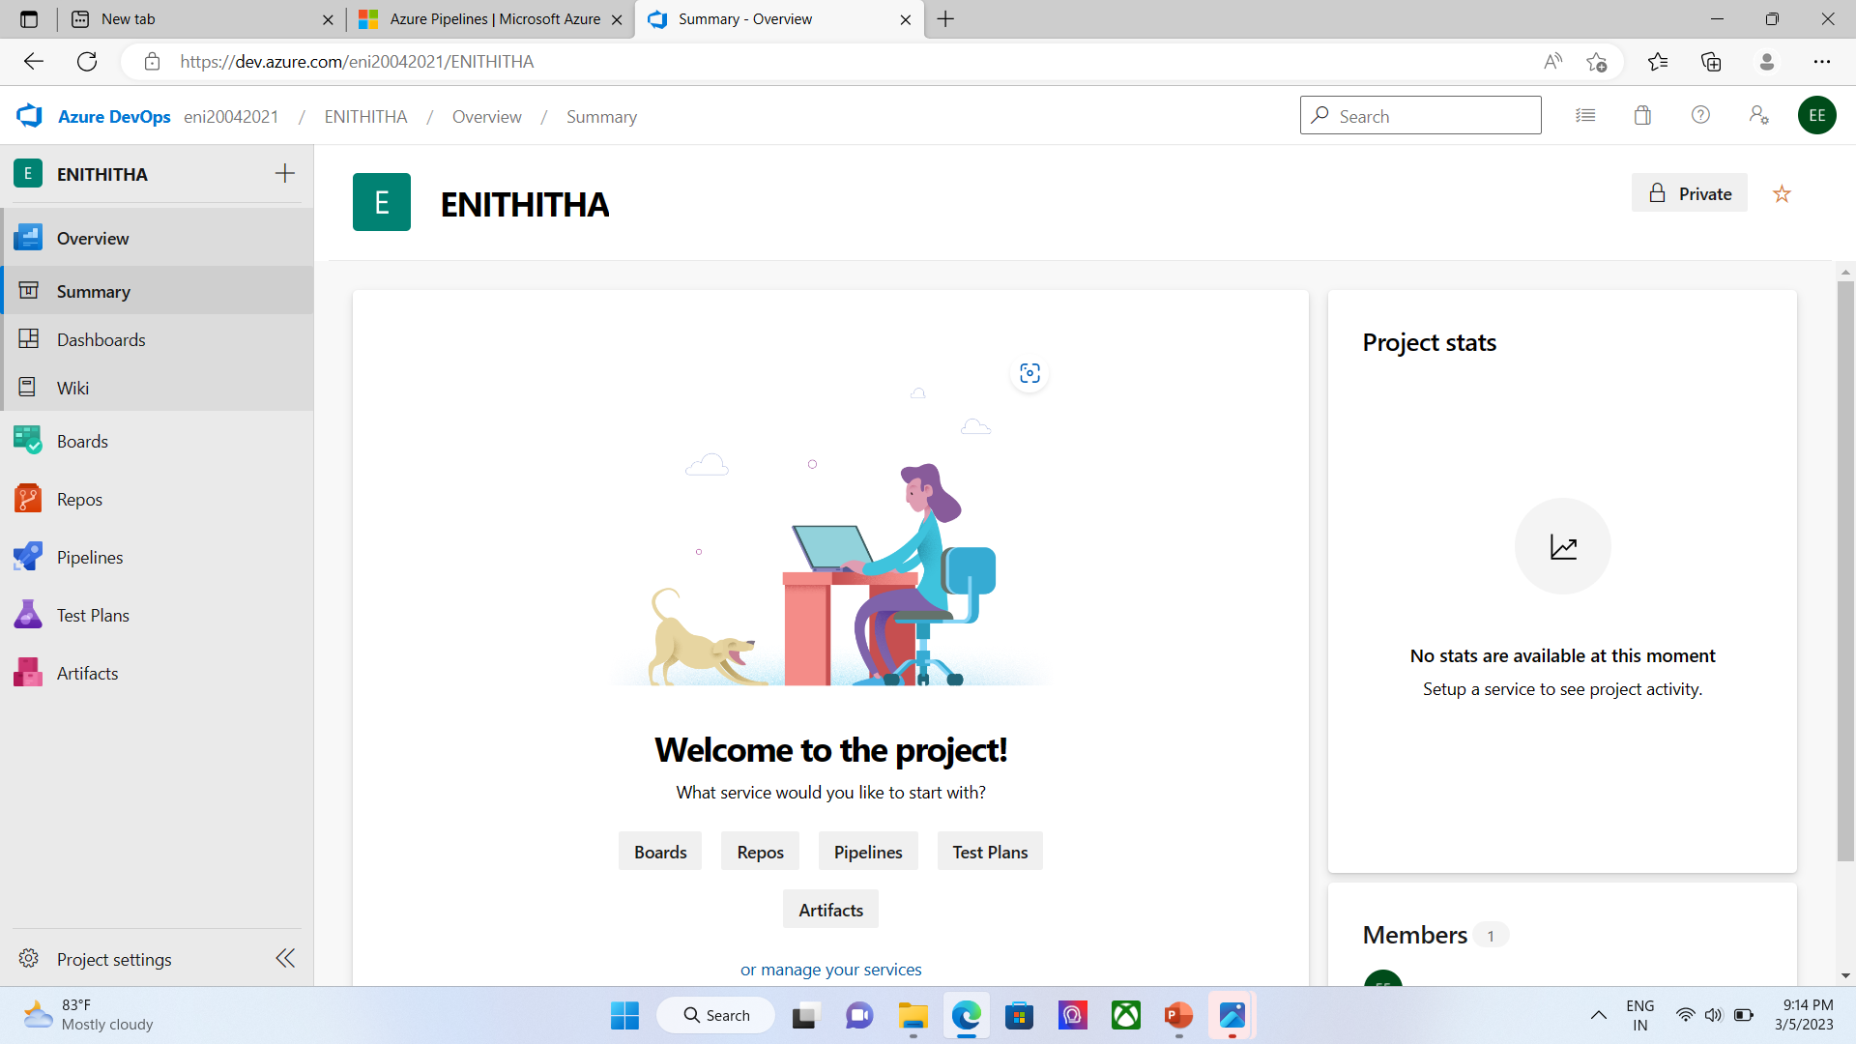
STEP5.In this organization, we will now be able to create projects with our CI/CD pipeline.

Slide 46
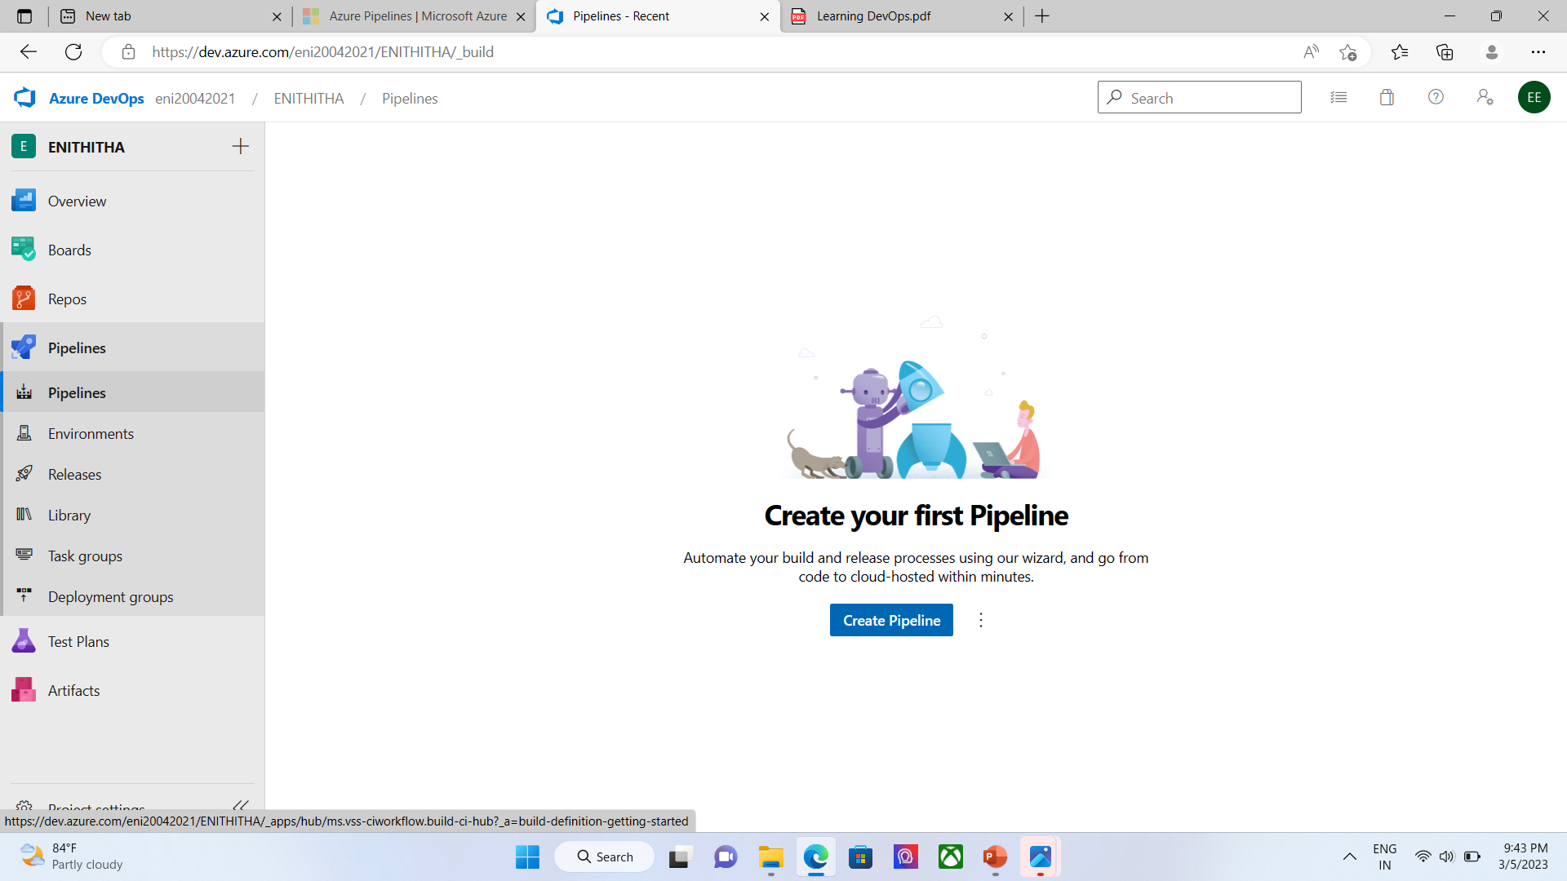

Slide 47
Versioning of the code with Git in Azure Repo
As we have mentioned, the first prerequisite for setting up a continuous integration process is to have the application code versioned in an SVC, and we will do this in Azure Repos by following these steps:
To start our lab, we will create a new project; Managing Your Source Code with Git, in the Starting with the Git Process section.
2. Then, in Azure Repos, we will import code from another Git repository by using the Import repository option of the repository menu, as shown in the following screenshot

Slide 48
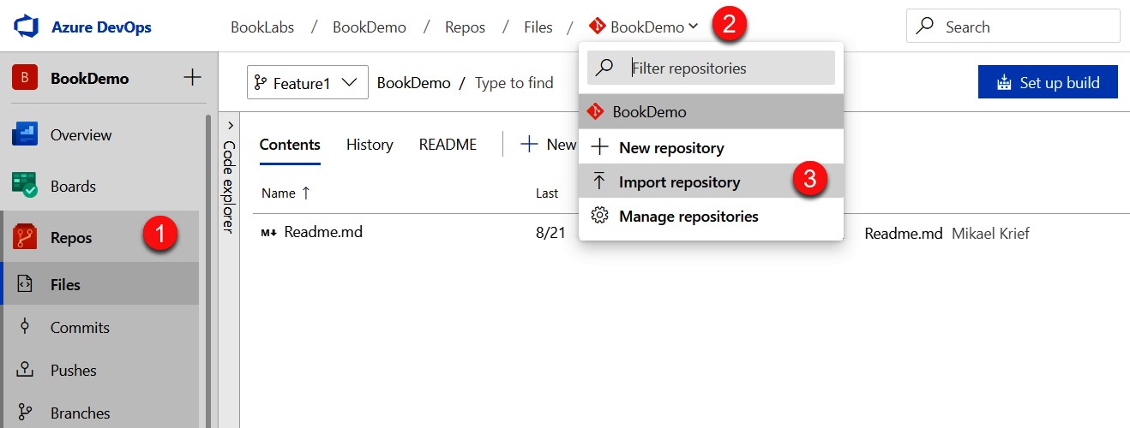

Slide 49
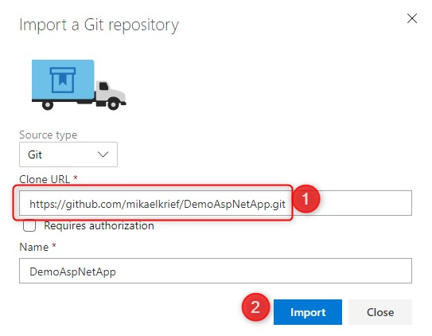
3. Once the Import a Git repository window opens, enter the URL of the Git repository whose sources we want to import. In our lab, we'll import the sources found in the https://github.com/mikaelkrief/DemoAspNetApp.git repository, as can be seen in the following screenshot

Slide 50
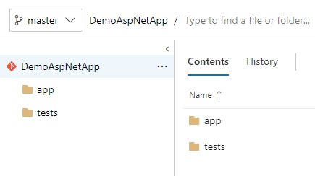
4. We'll click on the Import button, then we'll see that the code is imported into our repository. The following screenshot shows the code imported into our Azure Repos repository, which is an ASP.NET code application, and its unit tests:

Slide 51
-> Now that we have the code in Azure Repos, we'll set up a CI pipeline that will check and test the code at each user commit.

Slide 52
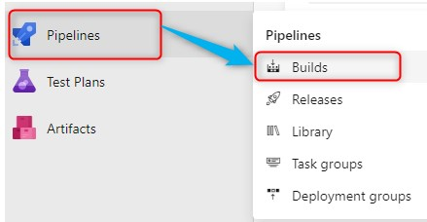
Creating the CI pipeline
We will create a CI pipeline in Azure Pipelines by following these steps:
-> To create this pipeline, open the Pipelines | Builds menu.
-> Then, click on the New pipeline button, as shown in the following screenshot:

Slide 53
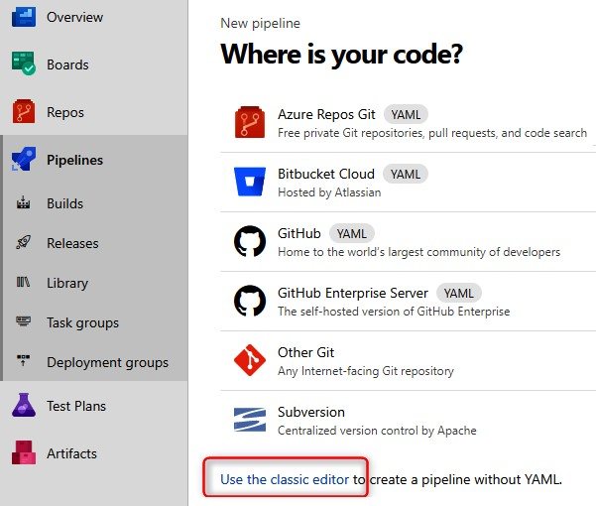
-> For the configuration mode, we choose the Use the classic editor option:

Slide 54
-> In Azure Pipelines, there is the choice of either the classic editor mode, which allows us to configure the pipeline via a graphical interface, or the YAML pipeline mode, which involves using a YAML file that describes the configuration of the pipeline. In this lab, we will use the classic editor mode, so that we can visualize the different options and configuration steps.

Slide 55
->The first configuration step of the pipeline consists of selecting the repository that contains the application's sources. Today, Azure Pipelines supports several types of Git, such as Azure Repos, GitHub, Bitbucket, and Subversion, and so on. We will therefore select Azure Repos Git in the repository that contains the imported sources, as shown in the following screenshot:

Slide 56
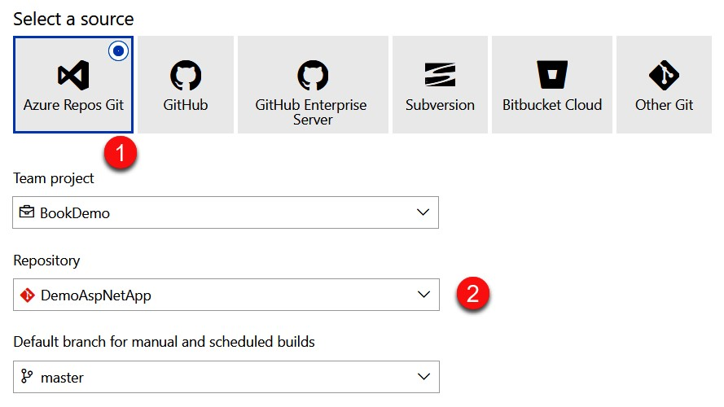

Slide 57
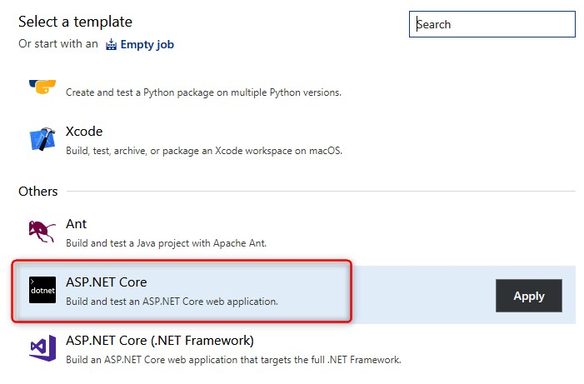
->Azure Pipelines proposes to select a build template that will contain all the preconfigured build steps; there is also the possibility to start from an empty template. Since our project is an ASP.NET core application, we will choose the ASP.NET Core template, as shown in the following screenshot:

Slide 58
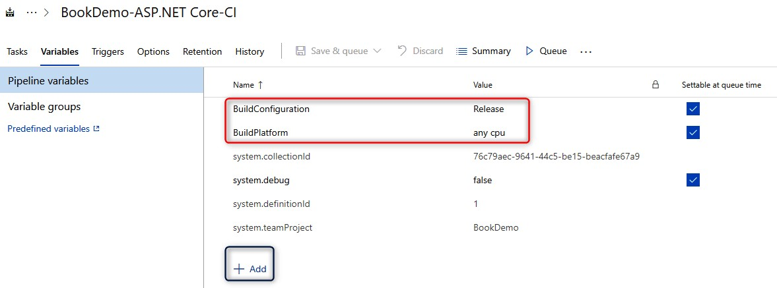
->We configure the Variables section, which allows us to fill in a list of variables in a key form, creating a value that can be used in the steps. The following screen shows the Variables tab of our build definition:

Slide 59
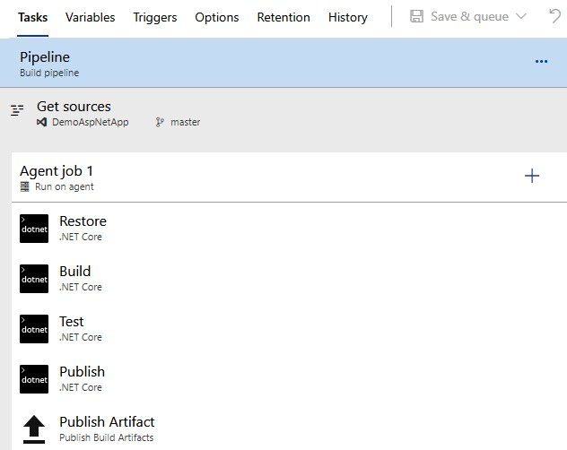
->We configure the Tasks tab, which contains the configuration of all the steps to be performed in the build.

Slide 60
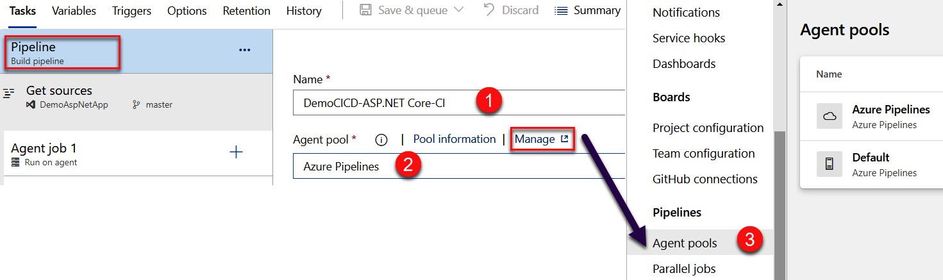

Slide 61
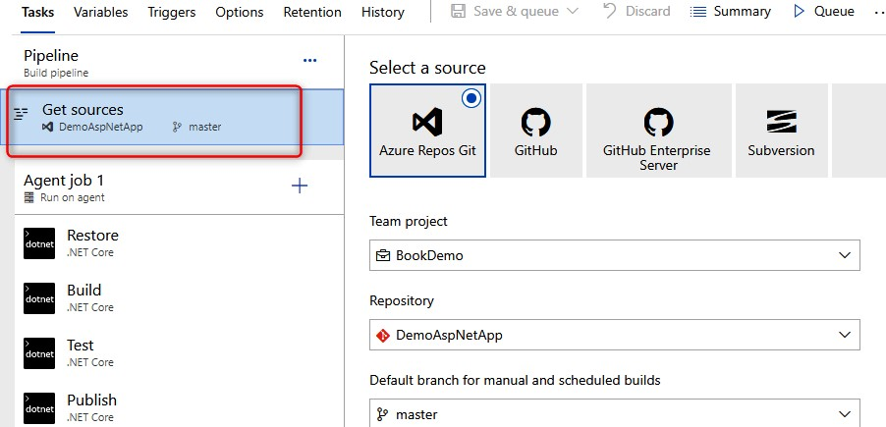
->Then, we have the Get sources phase, which contains the configuration of the sources that we did at the beginning; it is, however, possible to modify it here:

Slide 62
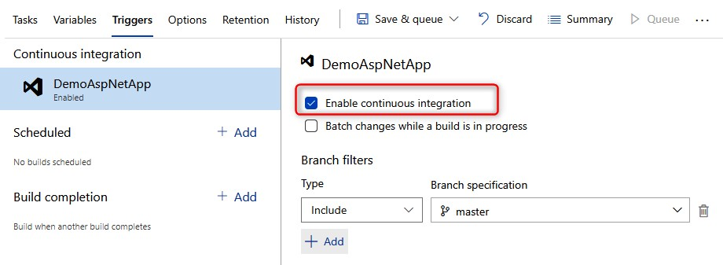
The last important configuration of our CI pipeline is the configuration of the build trigger in the Triggers tab to enable continuous integration, as shown in the following screenshot:

Slide 63
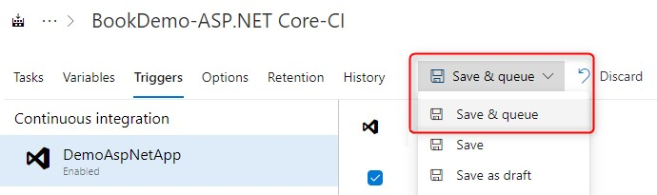
->The configuration of our CI or Build pipeline is complete; we validate and test its execution for the first time by clicking on the Save & queue button:
At the end of the execution of the build, we have some information, which helps us to analyze the status of the pipeline:

Slide 64
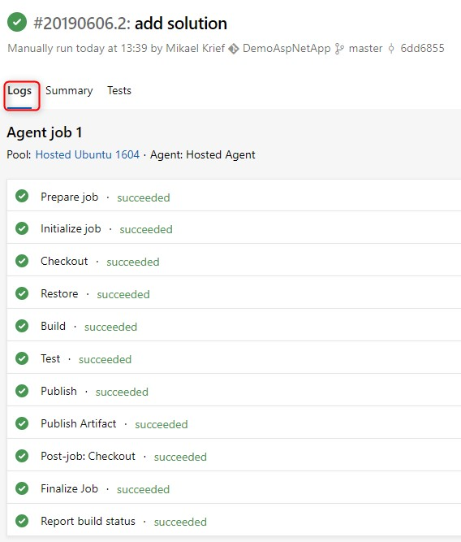
The following screenshot shows the execution logs:

Slide 65
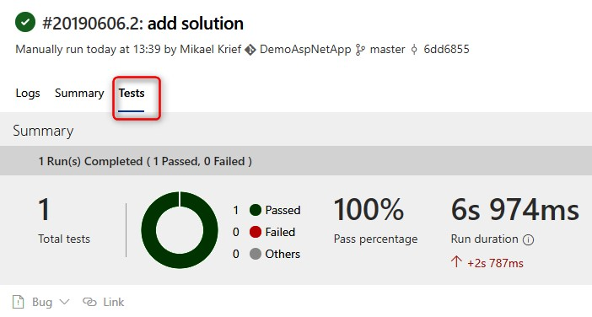
->The results of the execution of the unit tests are as follows:

Slide 66
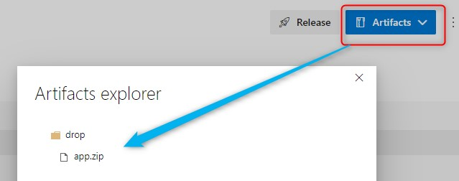
->The following shows the public artifacts.
->Now we know our CI build is configured and operational, we will create and configure a deployment release for the CD pipeline.

Slide 67
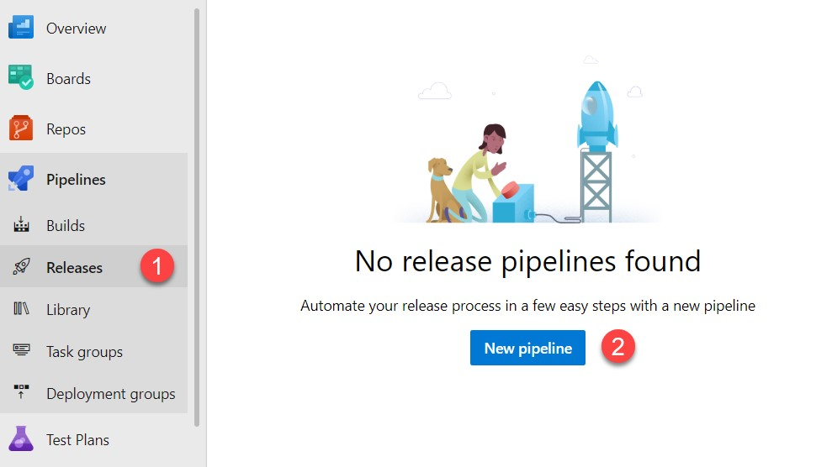
Creating the CD pipeline: the release
->To create the release definition, we go to the Releases menu and click on New pipeline, as follows:

Slide 68
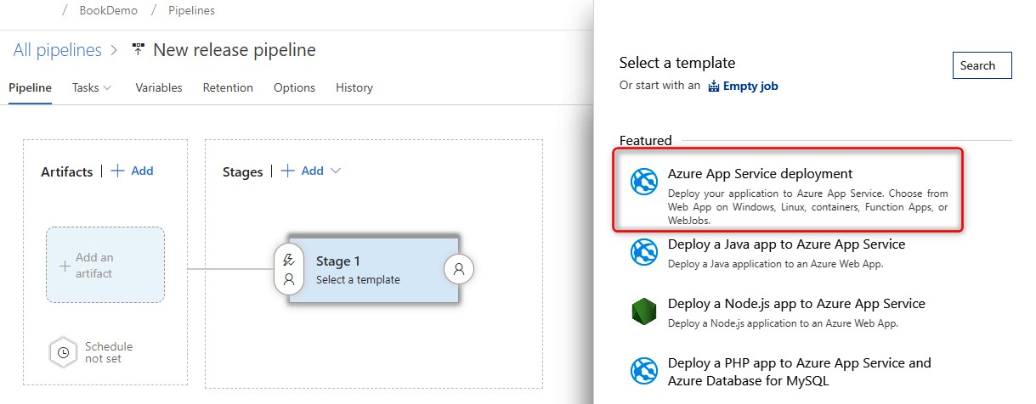
->As for the build, the first step of the configuration is to choose a template already configured. For this lab, we will choose the Azure App Service deployment template:

Slide 69
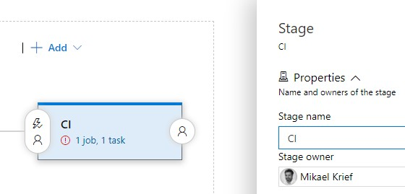
->Then, in the next window, the first stage is named, for example, CI as the continuous integration environment:

Slide 70
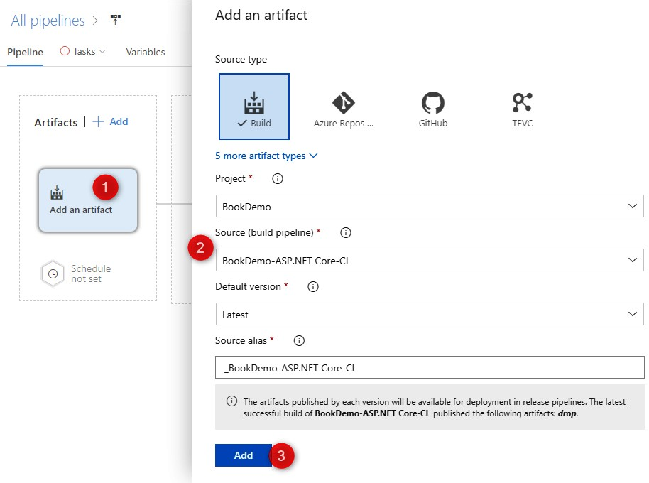
->We configure the entry point of the release in the artifacts part by adding an artifact that is the build definition previously created in the Creating the CI pipeline section, as follows:

Slide 71
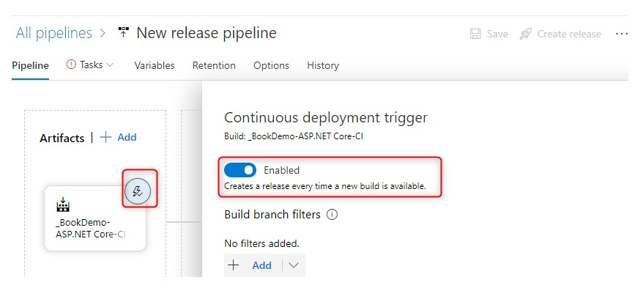
->We configure the automatic release trigger for each successful build execution:

Slide 72
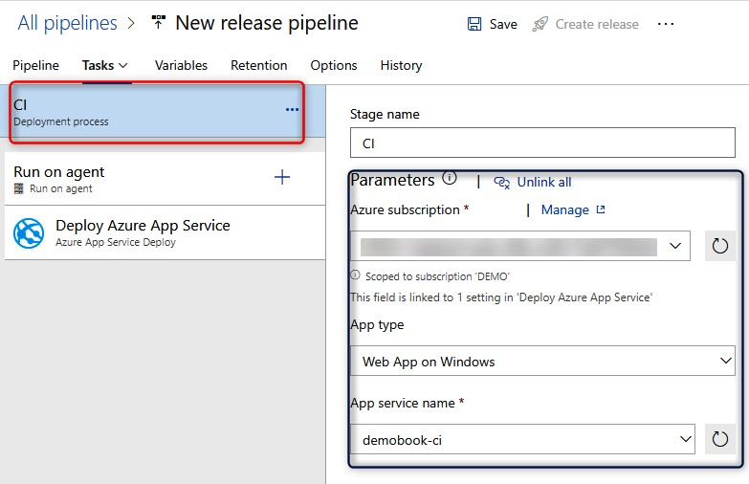
->Now, we'll configure the steps that will be executed in the CI stage; by clicking on the stage, we get exactly the same configuration window as the build: 1.The agent's choice over the Run on agent section 2.The configuration of the steps with their parameters

Slide 73
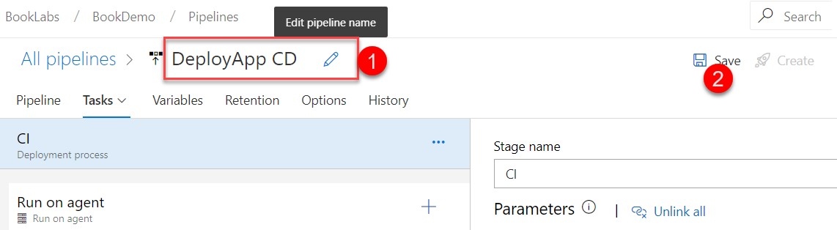
->We just have to rename the release with a name that simply describes what it does, and then we save it, as follows:

Slide 74
->Now, we complete our definition of the release with the deployment of the other environments (or stages). To simplify the manipulation, we will clone the CI environment settings in our release, and change the name of the app service name settings to the name of the web app like this. The following screenshot shows the clone environment action:

Slide 75
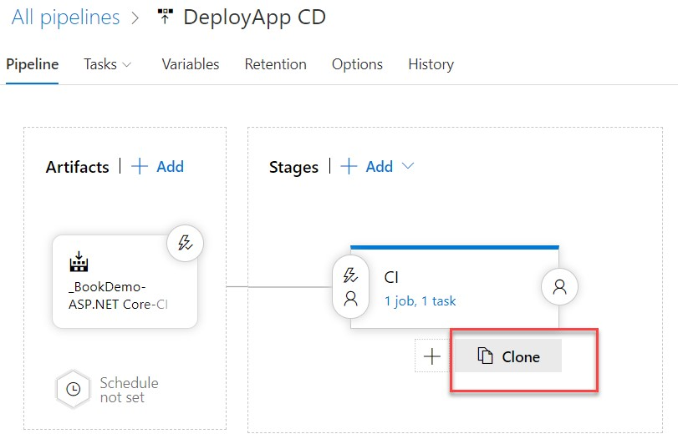

Slide 76
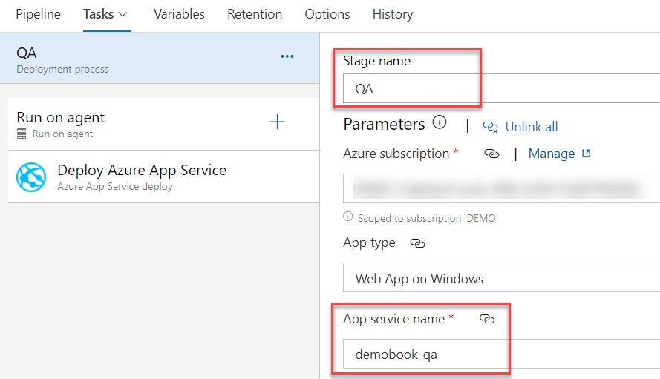

Slide 77
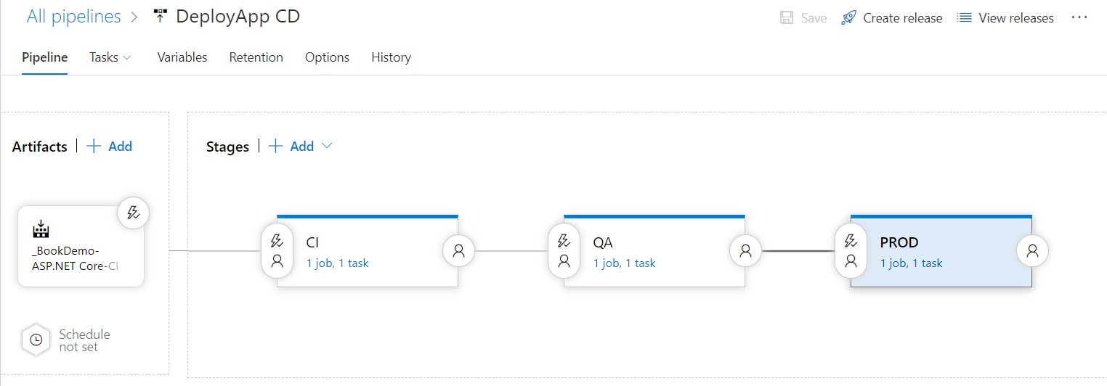
-> We finally get the release definition as follows:

Slide 78
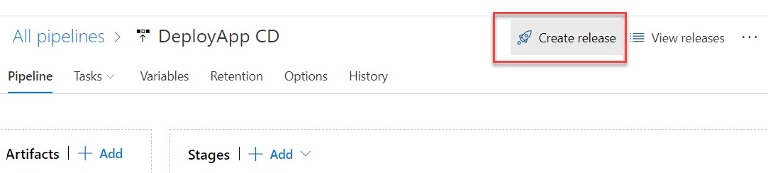
->To trigger the deployment of our application, we will create a new release by clicking on the Create release button:

Slide 79

->At the end of its execution, we can see its deployment status, as shown in the following screenshot:
->In this screenshot, we see that the deployment in the integration environment was successfully completed.

Slide 80

USING
USING GITLAB CI

Slide 81
CI PIPELINE
A continuous integration pipeline is a series of steps that must be performed in order to deliver a new version of software.
CI pipelines are a practice focused on improving software delivery throughout the software development life cycle via automation.
A pipeline is a process that drives software development through a path of building, testing, and deploying code, also known as CI/CD.

Slide 82


Slide 83
GitLab
GitLab is the most comprehensive DevSecOps Platform
The open source software project was created by Ukrainian developer Dmytro Zaporozhets and Dutch developer Sytse Sijbrandij.
GitLab is free for individuals.
GitLab offers a location for online code storage and capabilities for issue tracking and CI/CD.

Slide 84

What is GitLab CI ?
GitLab CI is one of the services offered by GitLab.
It is a cloud platform.
To catch bugs and errors early in the development cycle
GitLab CI/CD can automatically build, test, deploy, and monitor your applications by using Auto DevOps.
GitLab Auto DevOps is a collection of pre-configured features and integrations that work together to support your software delivery process

Slide 85
GitLab CI has the following features:
A source code manager
A CI/CD pipeline manager
A board for project management
GitLab CI/CD is a tool for software development using the continuous methodologies:
Continuous Integration (CI)
Continuous Delivery (CD)
Continuous Deployment (CD)

Slide 86
Continuous Integration
Consider an application that has its code stored in a Git repository in GitLab. Developers push code changes every day, multiple times a day. For every push to the repository, you can create a set of scripts to build and test your application automatically. These scripts help decrease the chances that you introduce errors in your application.

Slide 87
CONTINUED…
This practice is known as Continuous Integration. Each change submitted to an application, even to development branches, is built and tested automatically and continuously. These tests ensure the changes pass all tests, guidelines, and code compliance standards you established for your application.
GitLab itself is an example of a project that uses Continuous Integration as a software development method. For every push to the project, a set of checks run against the code.

Slide 88


Slide 89

GitLab CI workflow
This workflow shows the major steps in the GitLab process. You don’t need any external tools to deliver your software and you can visualize all the steps in the GitLab UI.

Slide 90


Slide 91

GitLab has a free price model with additional services that are subject to a charge; the price grid is shown as follows:

Slide 92
Benefits of GitLab CI
Ensure superior code quality
Deliver faster with an accelerated release rate
CI/CD pipelines: Automation reduces the cost
Fault isolation
Simplified rollback
Optimum transparency and accountability
Improved mean time to resolution (MTTR)
Monitoring metrics data
Reduction of non-critical defects in backlog

Slide 93

Other Services offered by GitLab
Team Planning
Portfolio Management
Requirements Management
Quality Management
Design Management
DevOps Reports
Source Code Management
Code Review Workflow
Web IDE
Wiki
Pages
GitLab CLI
Remote Development
Continuous Integration(CI)
Pipeline Composition
Secrets Management
Build Artifacts
Code Testing and Coverage
Package Registry
Container Registry
Helm Chart Registry
Dependency Proxy
SAST
Code Quality
DAST
Secret Detection
API Security
Container Scanning
Dependency Scanning
Fuzz Testing
Continuous Delivery
Advanced Deployments
Feature Flags
Release Evidence
Environment Management
Auto DevOps
Infrastructure As Code
Kubernetes Management
Incident Management
Service Desk
Error Tracking
On-call Schedule Managemet

Slide 94


Features Comparison
Project import from various external systems | ✔️ | ✔️
Ease of migration from other providers | ❌ | ✔️
Lock Discussion | ❌ | ✔️
Custom Notifications | ✔️ | ✔️
Rich Object Summary on Link Hover | ❌ | ❌
Powerful branching | ✔️ | ✔️
Protected branches | ✔️ | ✔️
Commit graph and reporting tools | ✔️ | ✔️
Required merge Request Approvals | ✔️ | ✔️
Multiple approvers in code review | ✔️ | ✔️
Approval rules for code review | ❌ | ✔️
Search files with fuzzy file finder | ✔️ | ✔️
Fast-forward merge with option to rebase | ✔️ | ✔️

Slide 95
Features Comparison
Squash and merge | ✔️ | ✔️
Reject unsigned commits | ❌ | ✔️
Verified Committer | ❌ | ✔️
Cherry-picked changes | ✔️ | ✔️
Sign Commits with GPG | ❌ | ✔️
Sign Commits with SSH | ❌ | ✔️
Sign Commits and Tags with X.509 | ❌ | ✔️

Slide 96
Authentication at GitLab
Creating a GitLab account is free and can be done either by creating a GitLab account or using external accounts, such as Google, GitHub, Twitter, or Bitbucket.
To create a GitLab account, we need to go to Checking your Browser - GitLab
and choose the type of authentication

Slide 97

Step 1:

Slide 98


Slide 99

Other methods to sign in:

Slide 100


Slide 101

Initially Creating a project:

Slide 102

To invite team members:

Slide 103
Creating a new project and managing your code source

Slide 104

Once your account has been created and authenticated, you will be taken to the homepage of your account .Click on New project on the home page

Slide 105


Slide 106


Slide 107


Slide 108


Slide 109

Choose any built-in template relevant to your project

Slide 110
To import code from an internal or external repository of another SVC platform

Slide 111


Slide 112

The code to import is located in an external SVC repository, as shown in the following screenshot:

Slide 113

To create a new gitlabdemo directory and then clone the content of example, which can be found at https://github.com/PacktPublishing/Learning_DevOps/tree/master/CHAP06 , in the gitlabdemo directory.

Slide 114
Execute the following commands in a terminal to push the code into the repository
git init
git remote add origin <git repo Url>
git add .
git commit -m "Initial commit"
git push -u origin master
Once these commands have been executed, we'll obtain a remote GitLab repository with the lab code.

Slide 115

The code of our application has been deposited in GitLab, and we can now create our CI process with GitLab

Slide 116
Creating the CI pipeline

Slide 117

In GitLab CI, the creation of a CI pipeline (and CD) is not done via a graphical interface, but with a YAML file at the root of the project.
This method, which consists of describing the process of a pipeline in a file that is located with the code, can be called Pipeline as Code
Step1:

Slide 118
At the beginning of this code that we use a microsoft/dotnet:latest Docker image that will be mounted in a container and in which the actions of the pipeline will be executed.
There are two stages: one for the build and one for the
test execution
2. Then, we will commit and push this file into the remote repository.
3. Just after pushing the code, we can see that the CI process has been triggered.
The CI pipeline was, therefore, triggered when the code was pushed into the repository.

Slide 119
Accessing the CI pipeline execution details

Slide 120

To access the execution details of the executed CI pipeline, follow these steps:
1. In the GitLab CI menu, we go to CI / CD | Pipelines, and we will see the list of pipeline executions

Slide 121

2. To display the details of the pipeline, we click on the desired pipeline execution:

Slide 122

We can see the execution status as well as the two stages that you defined in the pipeline YAML file. To view the details of the execution logs for a stage, we click on the stage
The execution of the scripts written in the pipeline YAML file

Slide 123
References
The code of yaml file: Learning_DevOps/gitlab-ci-demo.yml at master · PacktPublishing/Learning_DevOps · GitHub
The full documentation on the format and syntax of this .gitlab-ci.yml file:`.gitlab-ci.yml` keyword reference | GitLab
To create a GitLab account, we need to go to Sign in · GitLab
Learning DevOps page 202-212
The other services it offers are listed here: Features | GitLab
The price grid Pricing | GitLab

Slide 124
THANK YOU

